Slide 1
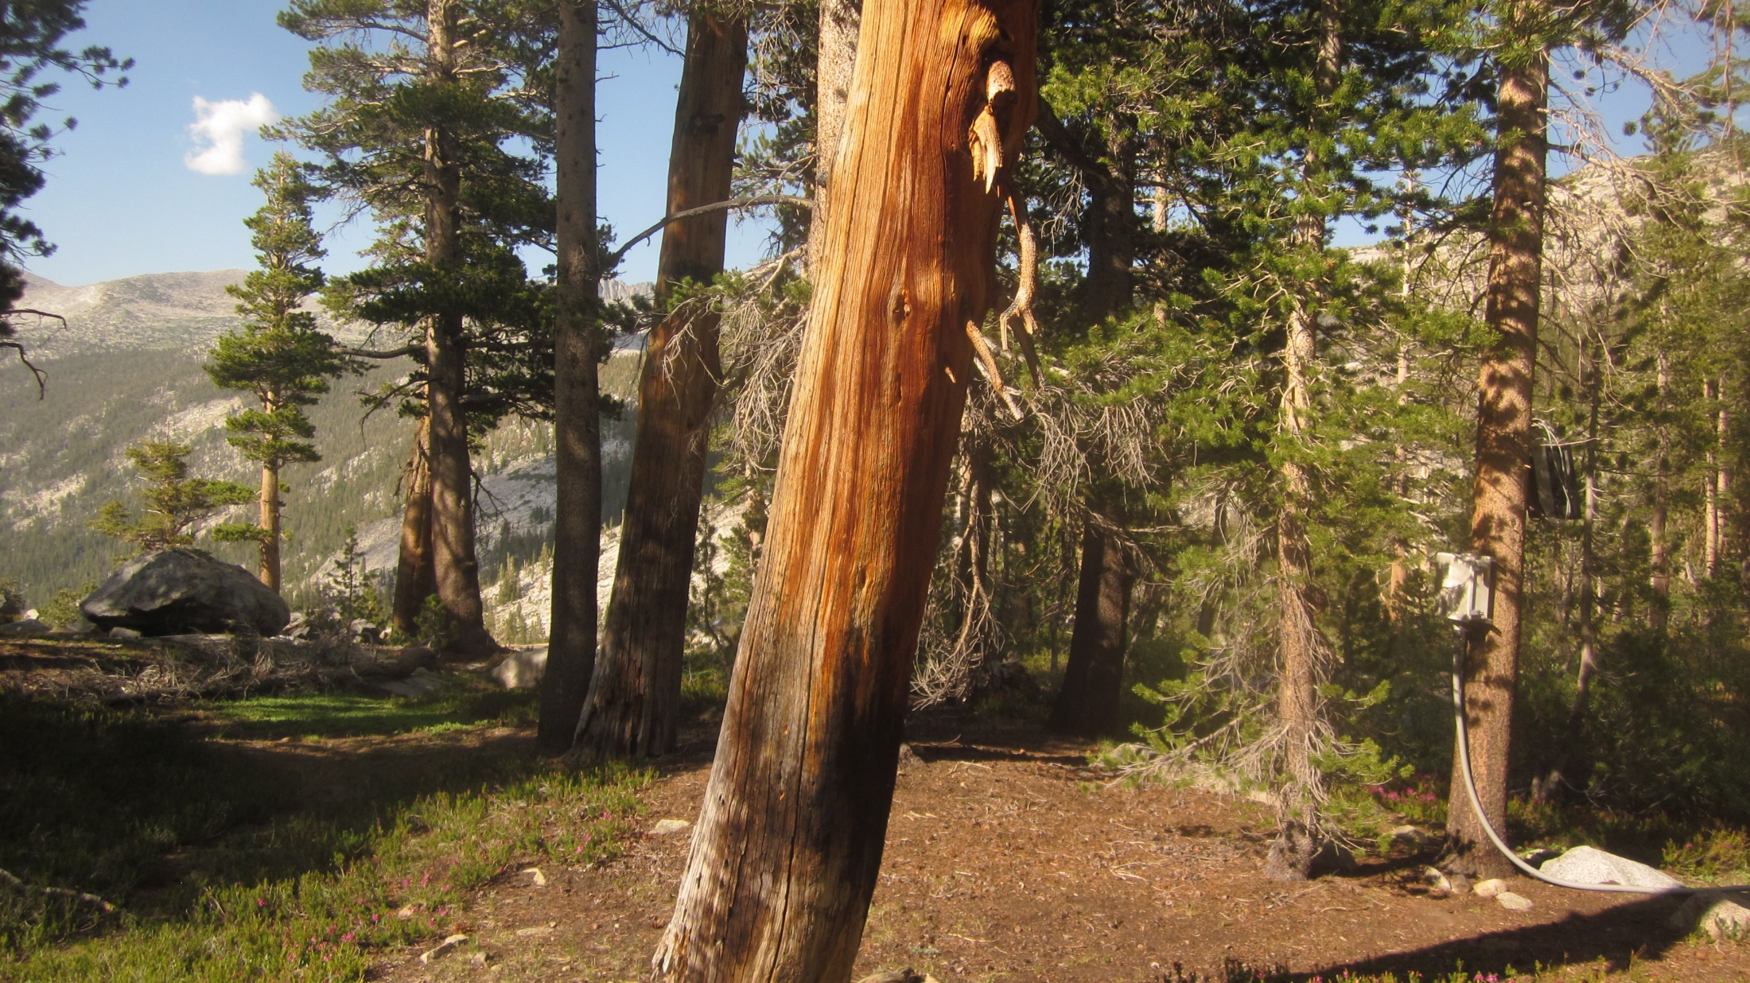
Maclure Cr. Gage:
updated 6/24/2015
Photo: 6/24/2015
Elevation: 10,020 ft
Lat: 37.7722 Long: -119.2644 Datum: WGS84
Photo: 7/24/2012

Slide 2
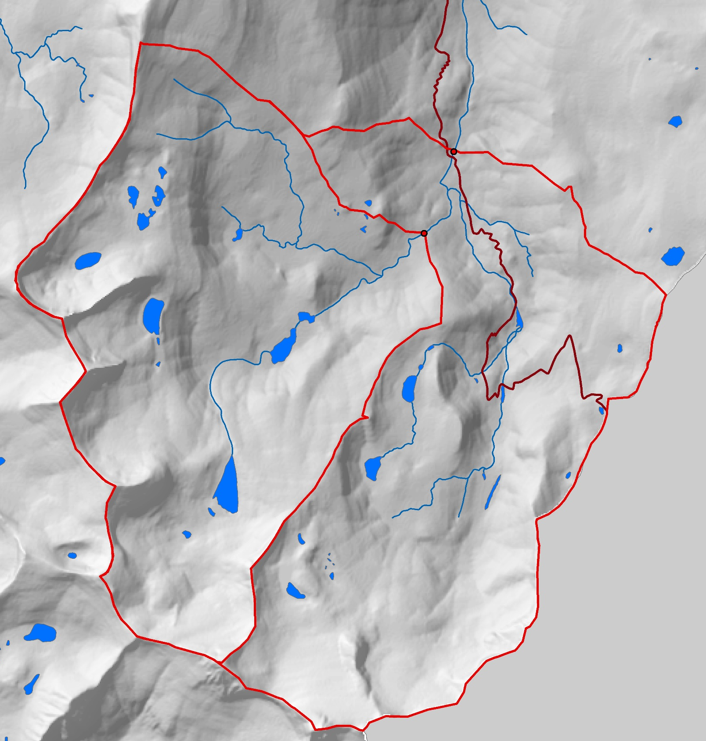
Lyell Fk. below
Maclure Cr
Maclure
Creek
JMT/PCT

Slide 3
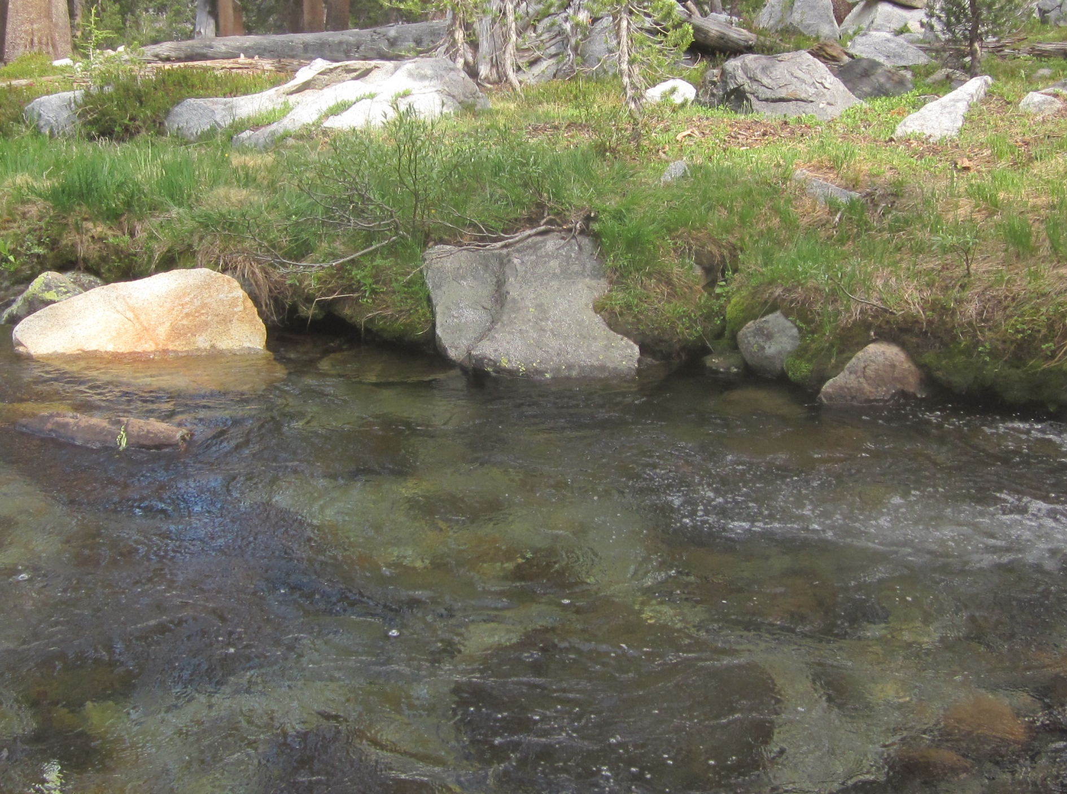
Old TD rebar, used as datum from 2012-2014 for WWQ
New LOW WATER TD bolt, TDB1
installed 6/24/2015
*measure from X on bolt*
FLOW
Vented P.T. mount,
CS 450 installed
6/15/2014,
(hard to see)
Photo: 6/24/2015

Slide 4
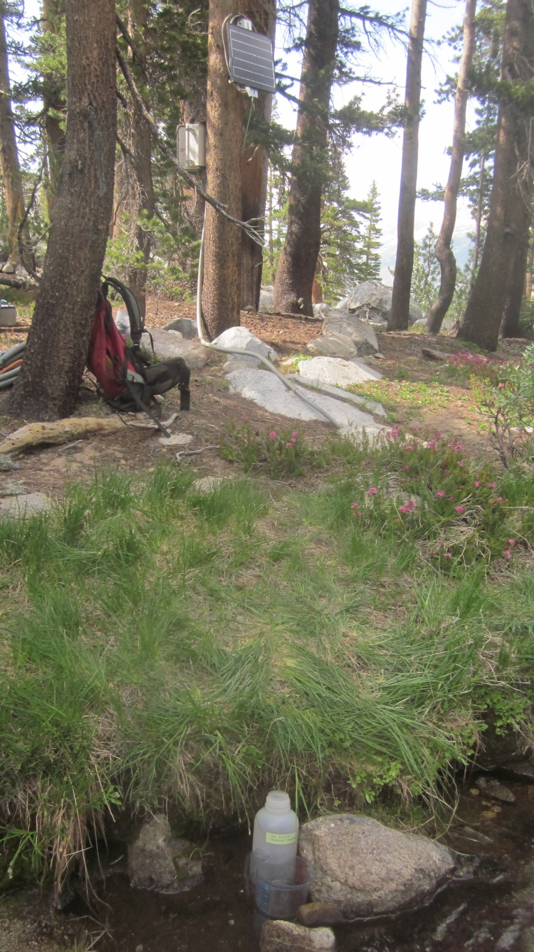
6/24/2015 Level survey notes:
Location | Benchmark manufacturer #s on stainless bolt heads | Actual Survey Rod measurements (ft.) | Relative Elevations (ft.) with making BM1=100' | Distance from BM1(ft.) | Azimuth from BM1(deg) | Notes
TDB1 Middle of X | F593C w/ X cut for TD measurements | 7.335+0.02=7.355 | 97.182 | 30.26 | 125 | TB1 is colocated w/ old rebar TD and can be used for low flows (on opposite side of river)
Old TD Rebar Top | NA | 7.235 | 97.302 | 30.22 | 125
TDB2 Top | 316 TH | 7.082 | 97.455 | 10.75 | 154 | TB2 is on river left and is oriented so that in high flows it can be measured under water.
BM1 Top | Bolt with cut X mark. | 4.537 | 100 | NA | NA | BM1 is on river left, between enclosure-tree and TDB2
BM1, between enclosure tree and TD B2
Photo: 6/24/2015
New HIGH WATER TD BOLT
TDB2, measure down to X. Gage height of
TDB2 top = 10.273

Slide 5
8/14/2018Level survey notes:
Location | Benchmark manufacturer #s on stainless bolt heads |  | Actual Survey Rod measurements (ft.) | Relative Elevations (ft.) with making BM1=100' | Difference from 2015 | Notes
TDB1 Middle of X | F593C w/ X cut for TD measurements |  | 4.805 | 96.755 | -0.427 | TB1 is located on boulder which appears to have fallen downward into the river. TDB1 is now 0.427 ft below where it was surveyed in 2015
TDB2 Top | 316 TH |  | 4.105 | 97.455 | 0 | TB2 is on river left and more stable. Should be used as primary tape down from now on.
BM1 Top | Bolt with cut X mark. |  | 1.56 | 100 | 0 | BM1 is on river left, between enclosure-tree and TDB2
Old TDB1 Middle of X |  |  |  | 10
TDB2 Top - Old TDB1 Middle of X |  |  |  | 0.273
TDB2 Top - New TDB1 Middle of X |  |  |  | 0.7
New Gage height TDB1 Middle of X |  |  |  | 9.573
Gage height of TDB2 Top |  |  |  | 10.273
Photo: 6/24/2015

Slide 6
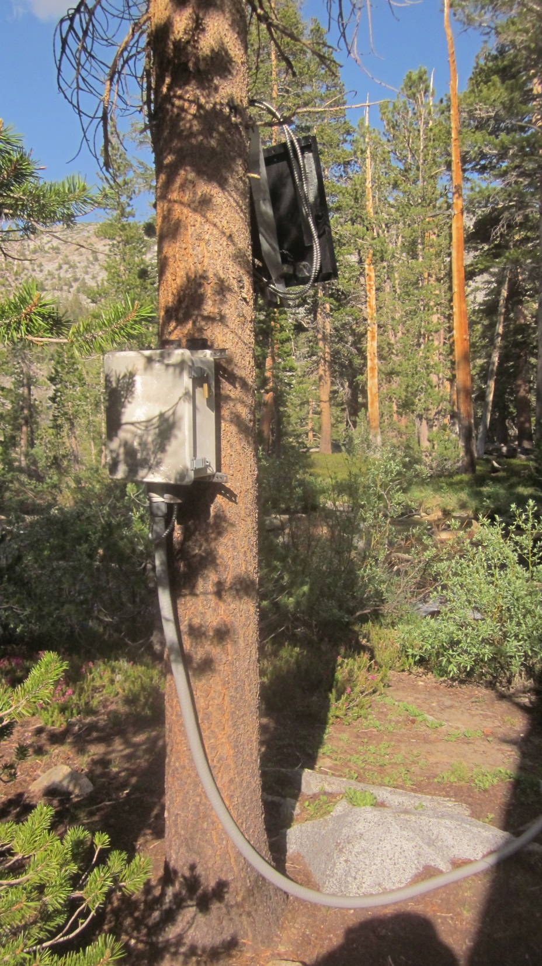
Station Inventory: 6/24/2015
Datalogger: CR1000 SN:11803
CS451-L Pressure Transducer 50’ cable, SN: 20010323
CS547 Spec Conductance 30’ cable, Kc: 1.38, SN: 6182
CH100 Charge controller 12V SN: 6668
12 Ah. Internal battery, 12V, Model: NP12-12T
20 Watt Extreme Power Corp Solar Panel
Data logger program stored under 6/24/2015 field visit
hydrometric notes In Aquarius .
Photo: 6/23/2015
Photo: 6/24/2015

Slide 7
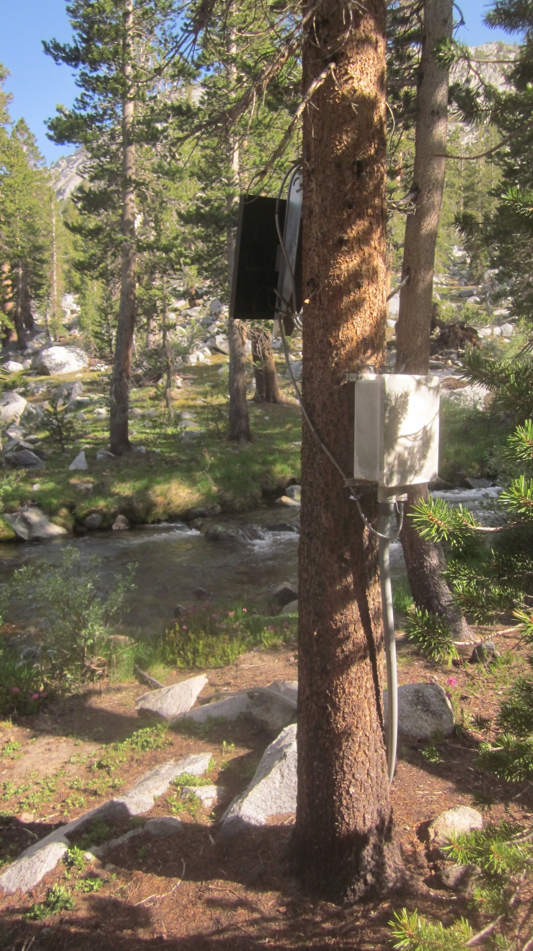
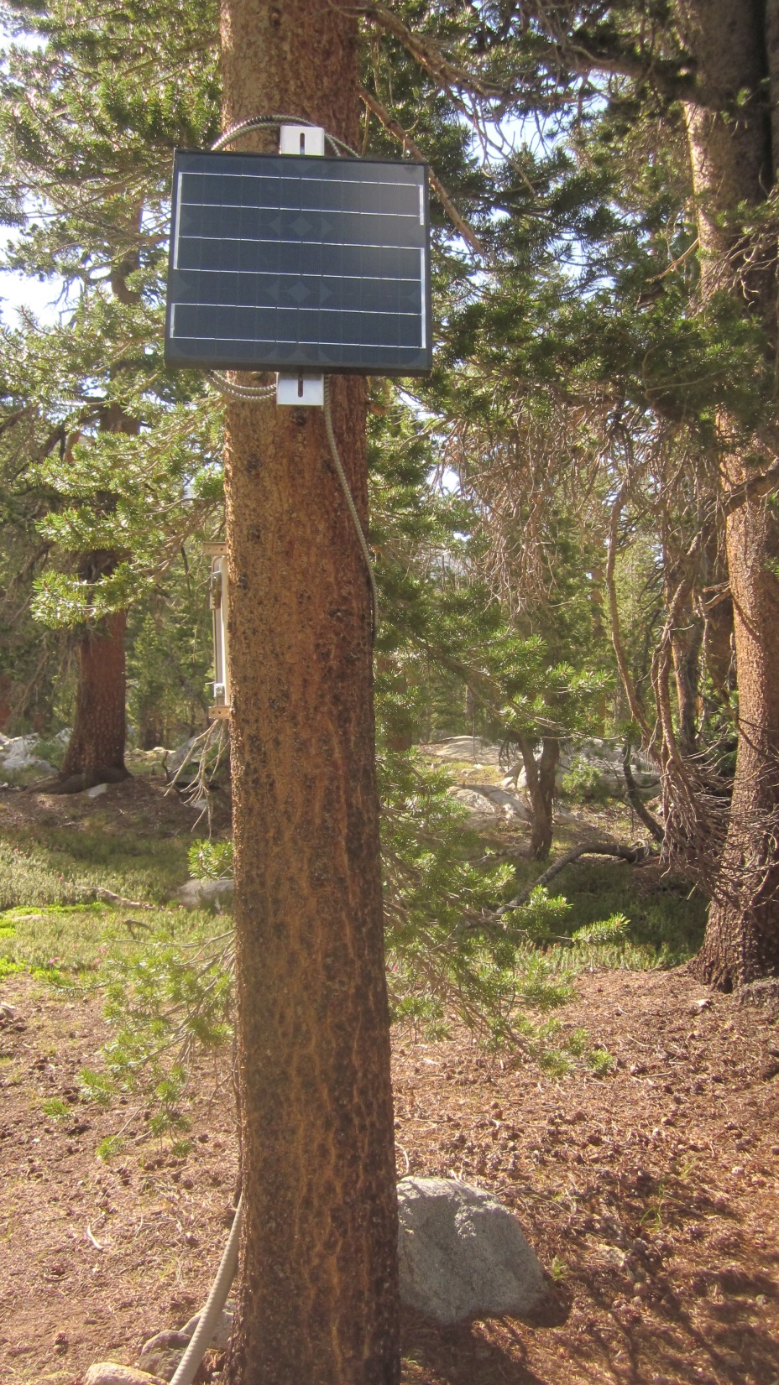
Photo: 6/23/2015

Slide 8
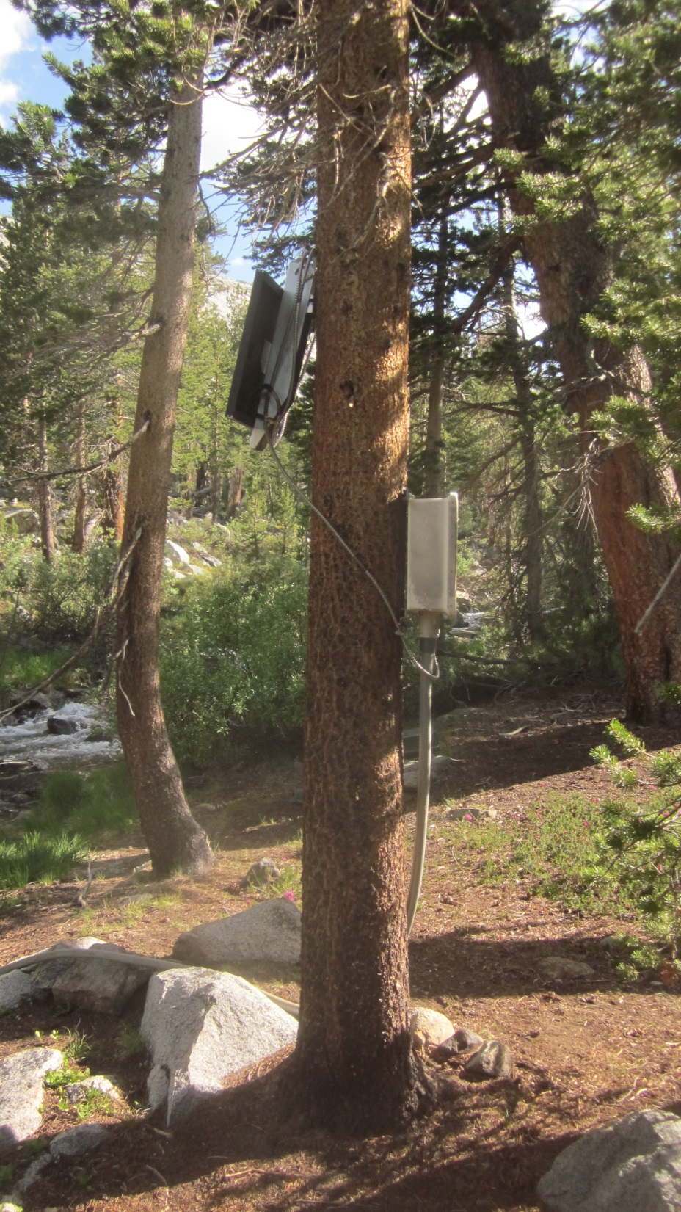
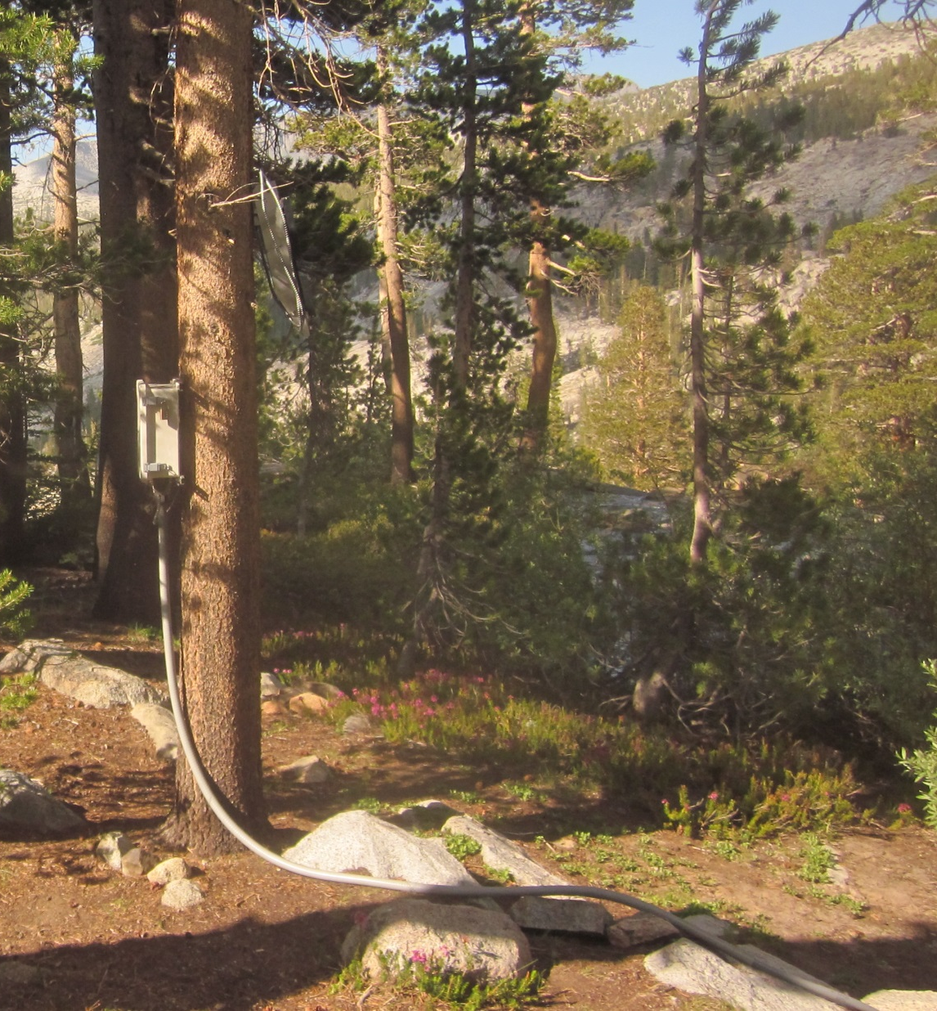
Photo: 8/21/2013
Photo: 7/24/2012

